Slide 1

Mad Libs Python Project
Hannah Melcher

Slide 2
Agenda
What is Mad Libs?
Building blocks of the program
4 steps to create the program
Sample output
Video demo
Summary
References

Slide 3
What is Mad Libs?
Mad Libs is a game created by Leonard Stern and Roger Price.
It is a very popular template word game where one player acts as the reader. They ask the other players, who have no knowledge of the story, to fill in the blanks by choosing adjectives, nouns, verbs, etc.
The result is a funny stupid story the players have fun reading and laughing over.

Slide 4
Building blocks of the game
User input
Ask the user to name what is being asked (adjective, noun, verb, etc.)
Print function
Print the story
Def() and return() function
Define the game
If/Else statements
Decide between choices based on user input

Slide 5
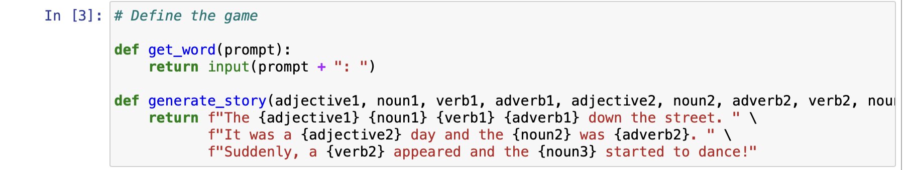
Step 1 – Define the function
get_word returns the prompt followed by the user’s input
generate_story returns the Mad Libs story created and fills in the values that were input by the user

Slide 6
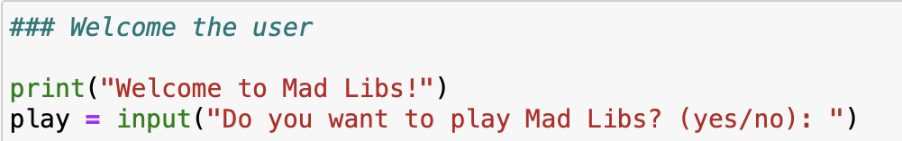
Step 2 – Welcome the user
Print statement welcomes the user to the game
The variable “play” asks for the user’s input if they wish to play the game or not
Input yes or no answer

Slide 7
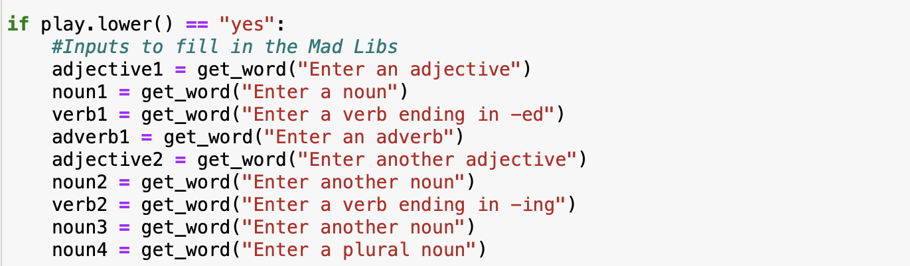
Step 3 – User inputs
If the user chose yes, they are then directed to where they will input their answers
User inputs the desired descriptive word (adjective, noun verb, etc.)
Each input is assigned to a variable relating to the descriptive word asked for and is used to generate the story in the next step

Slide 8
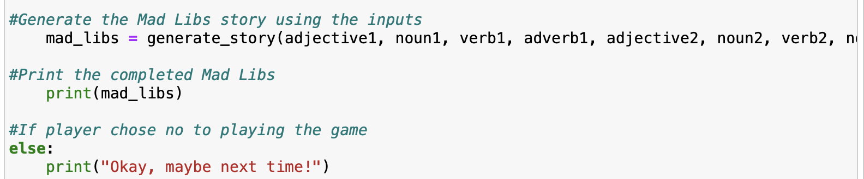
Step 4 – Generate and complete the story
mad_libs variable stores the completed story
Print function calls on the mad_libs variable and returns that completed story
If the user input that they do not want to play the game earlier, the program prints “Okay, maybe next time!” and the program ends

Slide 9
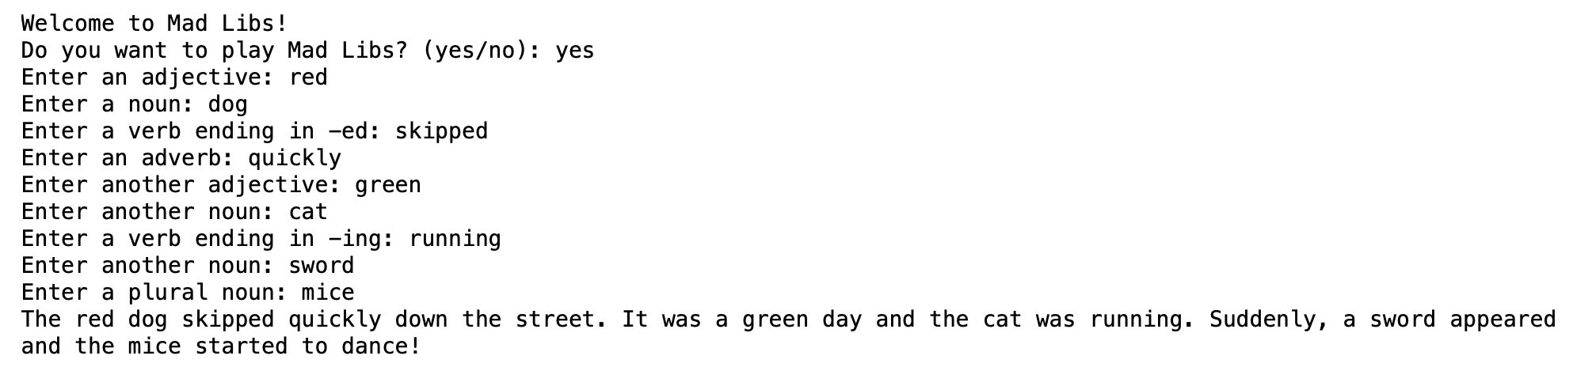
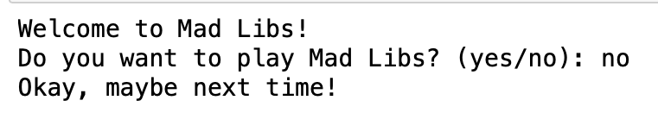
Sample Outputs
If user input yes
If user input no

Slide 10
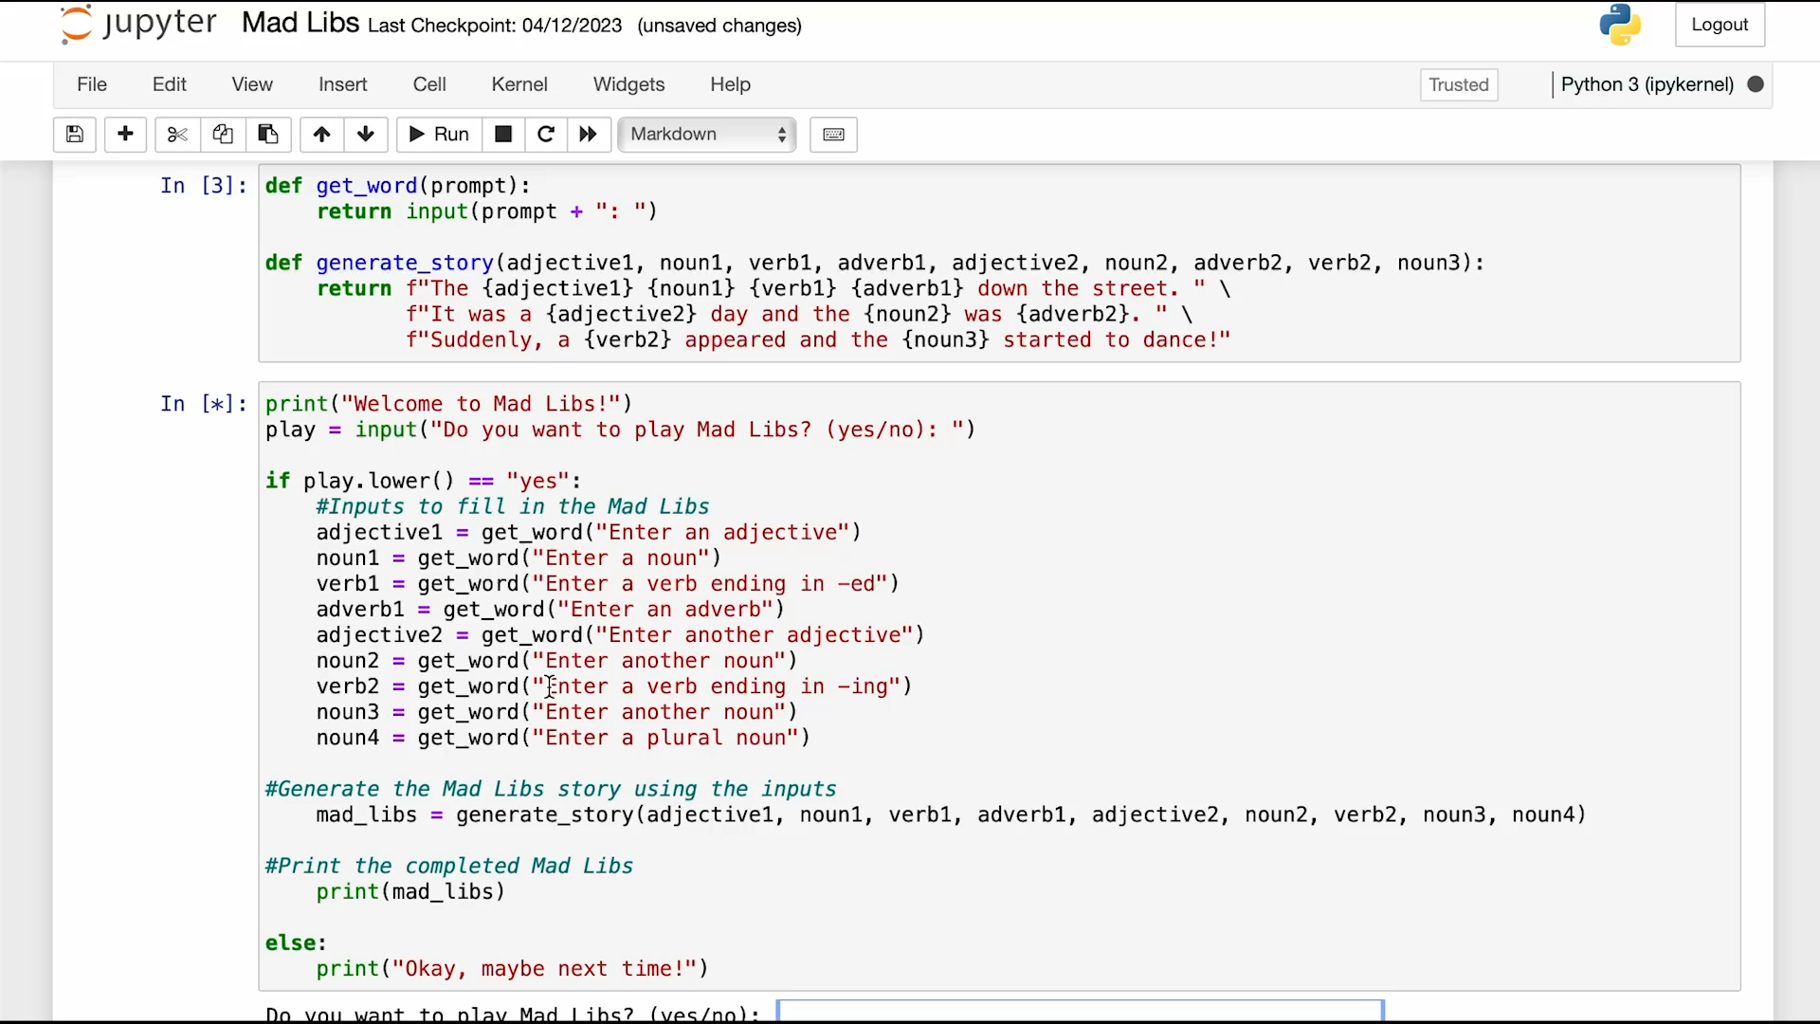
Video Demo

Slide 11
Summary
Mad Libs is a popular template game that can be played through a Python program
In order to complete the program successfully, 4 steps must be completed before one can run the game:
Define the function
Welcome the user
Allow for user inputs to the descriptive words
Generate and complete the story

Slide 12
Thank you!

Slide 13
References
http://www.madlibslive.com/whats-a-mad-lib
https://www.madlibs.com/history/
https://hobbylark.com/party-games/How-to-Make-Your-Own-Mad-Libs

